Slide 1
Battle of Neighborhoods- NY and Toronto
IBM Professional Data Science Certificate Capstone presentation
By Anand R.Iyer
6th Feb 2021

Slide 2
Introduction
Comparison of the neighborhoods of NY and Toronto to find out the similarities between them. This data can give us a picture of the popular venues and the common ones to give a guess as to how similar they are.

Slide 3
Data
We use Wikipedia to obtain data, some available data and using portals like foursquare to call out the geographical data to support our analysis.
Further we will use this data to create data frame , draw bar graphs and analyse as to how similar these neighborhoods are
This data will also be used to explore and cluster these neighborhoods.

Slide 4
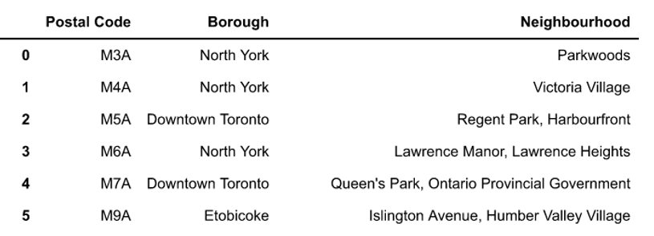
Toronto and NY with their boroughs and neighborhoods

Slide 5
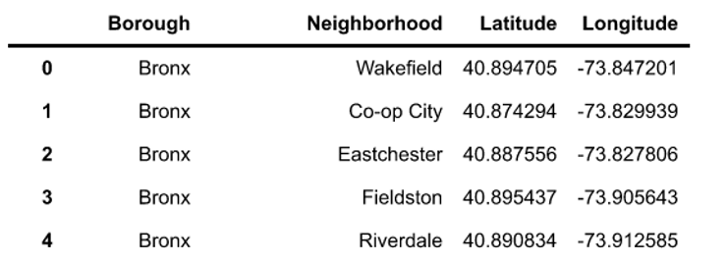
Toronto and NY with their boroughs and neighborhoods

Slide 6
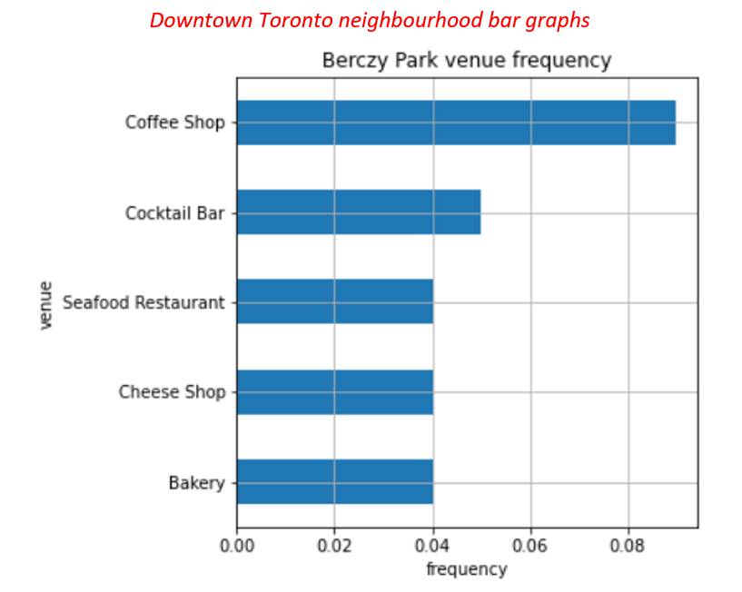
Methodology : Exploring and Clustering

Slide 7
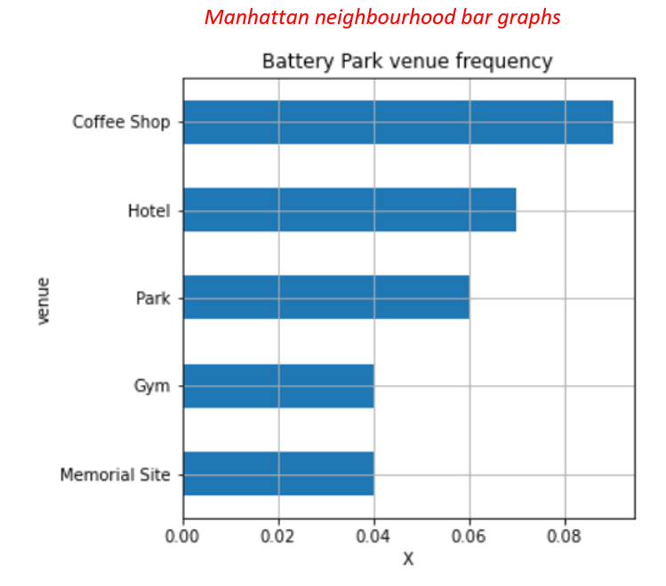
Methodology : Exploring and Clustering

Slide 8
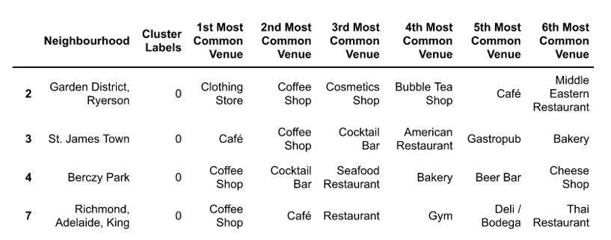
Methodology : Exploring and Clustering
Using k-means to cluster the neighborhoods into 5 clusters. Preparing data frames for the respective neighborhoods and the top 10 venues.

Slide 9
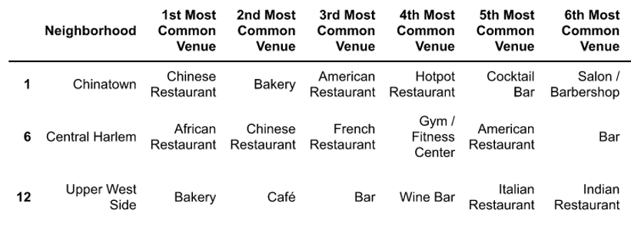
Methodology : Exploring and Clustering

Slide 10
Conclusion
Data analysis gives us an idea of popular venues in neighborhood
Comparison of these cities tells us more about the popular venues around
We get to know the venues are similar which point out to the social atmosphere in terms of preferences.

